Slide 1









Whiteboardmaths.com
7
2
1
5
© 2004 All rights reserved

Slide 2


Slide 3

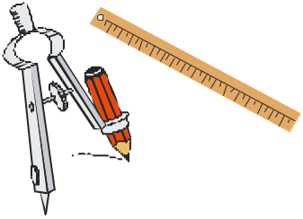
Circle
Loci
The locus of a point is the path traced out by the point as moves through 2D or 3D space. In Loci problems you have to find the path for a given rule/rules.
1. The locus of a point that moves so that it remains a constant distance from a fixed point p?
Draw the locus of a point that moves so that it is always 4cm from the fixed point p.
p
p
4 cm
A circle

Slide 4
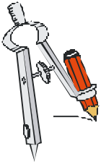
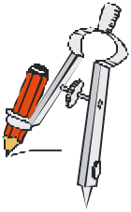
Perp Bisect
Loci
The locus of a point is the path traced out by the point as it moves.
2. The locus of a point that moves so that it remains equidistant from 2 fixed point points?
Draw the locus of the point that remains equidistant from points A and B.
2. Place compass at A, set over halfway and draw 2 arcs
4. Draw the perpendicular bisector through the points of intersection.
3. Place compass at B, with same distance set and draw 2 arcs to intersect first two.
1. Join both points with a straight line.
p₁
p₂
A
B
The perpendicular bisector of the line joining both points.

Slide 5
Angle Bisect
Loci
The locus of a point is the path traced out by the point as it moves.
3. The locus of a point that moves so that it remains equidistant from 2 fixed lines as shown?
Draw the locus of the point that remains equidistant from lines AC and AB.
1. Place compass at A and draw an arc crossing both arms.
3. Draw straight line from A through point of intersection for angle bisector.
2. Place compass on each intersection and set at a fixed distance. Then draw 2 arcs that intersect.
C
C
A
B
A
B
The Angle Bisector

Slide 6
Race track
Loci
The locus of a point is the path traced out by the point as it moves.
4. The locus of a point that moves so that it remains equidistant from a fixed line AB?
Two lines parallel to AB
A
B
Semi-circular ends

Slide 7
Loci
The locus of a point is the path traced out by the point as it moves.
Draw the locus of a point that remains 4 cm from line AB.
Draw 2 lines parallel to AB of equal length and 4cm from it.
Place compass on ends of line and draw semi-circles of radii 4cm.
4cm
A
B
4cm

Slide 8

SOME OTHER INTERESTING LOCI AND THEIR PROPERTIES

Slide 9
Ellipse
Loci
The locus of a point is the path traced out by the point as it moves.
Can you figure out what the locus of a point that moves according to the following rule is? The sum of its distances from 2 fixed points is constant.
You can draw an ellipse by looping string around two drawing pins or pegs. Move the pencil but keep the string taut as you draw.
a
b
An Ellipse
a + b has to remain constant

Slide 10
Conic
Loci
The locus of a point is the path traced out by the point as it moves.
You can draw an ellipse by looping string around two drawing pins or pegs. Move the pencil but keep the string taut as you draw.
ellipse
circle
The ellipse as an important curve in science and mathematics. The Greeks discovered it about 2000 years ago by taking an oblique slice through of a cone.

Slide 11

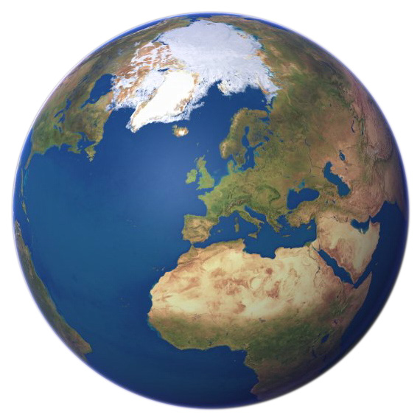
Loci
The locus of a point is the path traced out by the point as it moves.
You can draw an ellipse by looping string around two drawing pins or pegs. Move the pencil but keep the string taut as you draw.
1571-1630
A very important discovery was made by the German mathematician Johann Kepler in 1609. He discovered that as the planets orbit the sun, they follow elliptical paths and not circular as was previously thought.

Slide 12
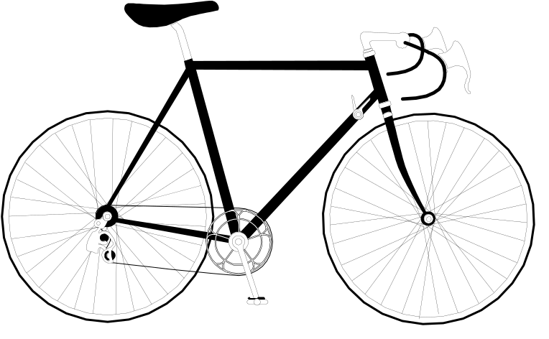
Cycloids
Loci (The Cycloids)
The locus of a point on the circumference of a circle that rolls along a straight line (like a bicycle wheel) is called a cycloid.
Mark a point on the bottom of a circle on some card and try and plot the position of the point as it moves during a complete revolution. Plot about 7 points. (Don’t let it slip)
Cycloidal Curve
Start
Full revolution

Slide 13



Loci (The Cycloids)
The locus of a point on the circumference of a circle that rolls along a straight line (like a bicycle wheel) is called a cycloid.
Distance travelled by point in 2nd ¼
Distance travelled by point in 1st ¼
Start
Full revolution
Notice that the equal distances travelled by the circle along the straight line do not correspond to those travelled by the point along its cycloidal path.

Slide 14
Loci (The Cycloids)
The locus of a point on the circumference of a circle that rolls along a straight line (like a bicycle wheel) is called a cycloid.
There is always a single point on the circumference of a moving circle or wheel that is not moving!

Slide 15



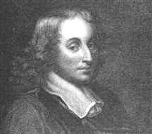
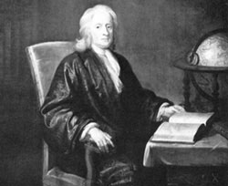
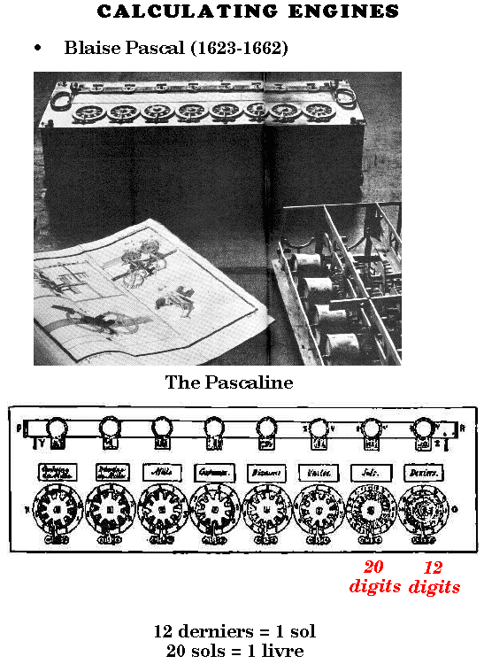
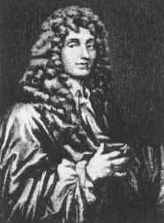

Brachistochrrone
The Brachistochrone Problem
Johann Bernoulli, (Jakob’s) younger brother gave this famous problem as a challenge to the European mathematical community by publishing it in Leibniz’s (Newton’s great rival) journal in June 1696. He gave a deadline of 1st January 1697 to solve it. The problem is to find the curve that gives the path of fastest descent between 2 points, such as A and B (B not directly below A). There are an infinite number of curves that could pass through points A and B, but which one gets you there in the shortest time?
A
?
Johann Bernoulli 1667-1748
Jakob Bernoulli 1654-1705
Gottfreid Leibniz 1646-1716
Blaise Pascal 1623 - 1662
Isaac Newton 1642 - 1727
At Easter, Johann received 5 letters containing solutions including his own and one from his elder brother. One of the letters bore an English postmark. When he opened it he saw the correct solution and although unsigned he realised that his challenge had been answered directly. He is reported to have put down the letter in dismay and said “I recognise the lion by his paw” Even mathematicians like Pascal and Huygens who were intimately familiar with this curve (Huygens built a pendulum utilising its properties) could not solve the problem.
Newton was living in London with his niece, Catherine Conduitt at the time and she remembers the day the letter arrived. “Sir Isaac was in the midst of the hurry of the great re-coinage and did not get home until four in the afternoon from the Tower and felt very much tired, but did not sleep until he solved it, which was by four in the morning” He is reported to have said later that “I do not like to be teased by foreigners about mathematical things”
It is likely that Johann had Newton in his sights when he set this problem. By the deadline he had received only one solution and that was from Newton’s bitter rival Leibniz. Leibniz graciously extended the deadline until Easter, in order to give others more time to tackle this very difficult problem. Newton had finished with mathematics by this time and was working at the mint in London. He probably had not heard of the problem, so Johann wrote to him directly about it.
The curve was part of an inverted Cycloid!
B
Or it could be part of the curve of a parabola.
It could be a straight line
It could be part of the curve of an ellipse.
It could be part of the circumference of a circle.
Christian Huygens 1629-1695

Slide 16
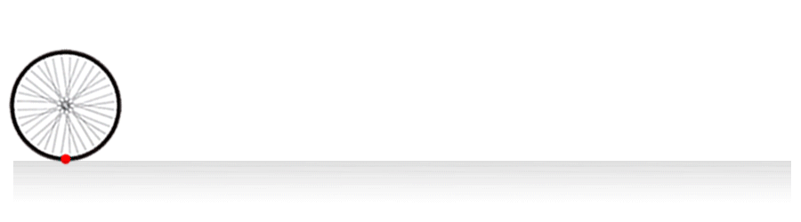
Wheel
The Wheels in Motion

Slide 17
Loci (The Cycloids)
A Cardiod is the name given to the curve that is traced out by the path of a point on the circumference of a circle that rolls around the outside of a fixed circle of equal radius.
r
Cardioid
r
Fixed Circle

Slide 18
A Cardiod is the name given to the curve that is traced out by the path of a point on the circumference of a circle that rolls around the outside of a fixed circle of equal radius.
Cardioid Moving
Cardiod
Cardioid
r
r
Fixed Circle

Slide 19
Loci (The Cycloids)
A Nephroid is the name given to the curve that is traced out by the path of a point on the circumference of a circle that rolls around the outside of a fixed circle of twice its radius.
r
2r
Fixed Circle
Nephroid

Slide 20
A Nephroid is the name given to the curve that is traced out by the path of a point on the circumference of a circle that rolls around the outside of a fixed circle of twice its radius.
Nephroid Moving
Nephroid
r
2r
Fixed Circle
Nephroid

Slide 21
Loci (The Cycloids)
The Epicycloid of Cremona is the name given to the curve that is traced out by the path of a point on the circumference of a circle that rolls around the outside of a fixed circle of 3 times its radius.
r
3r
Epicycloid
Fixed Circle
Epicycloid of Cremona

Slide 22
The Epicycloid of Cremona is the name given to the curve that is traced out by the path of a point on the circumference of a circle that rolls around the outside of a fixed circle of 3 times its radius.
Epicycloid Moving
Epycycloid
r
3r
Fixed Circle
Epicycloid of Cremona

Slide 23
Ladder
Loci
The Locus of a point on a slipping ladder.
A
B
C
Hello
Choose the locus of the point as the ladder slips down the wall to the floor. (Diagrams slightly exaggerated)
Point on ladder
Ouch

Slide 24
Loci
The Loci of a point on a slipping ladder.
A
B
C
Hello
Choose the locus of the point as the ladder slips down the wall to the floor. (Diagrams slightly exaggerated)

Slide 25

EX Q 1
Loci (Dogs and Goats)
Scale:1cm = 2m
Buster the dog is tethered by a 10m long rope at the corner of the shed as shown in the diagram. Draw and shade the area in which Buster can move.
Shed
1. Draw ¾ circle of radius 5 cm
2. Draw ¼ circle of radius 2 cm
3. Shade in required region

Slide 26


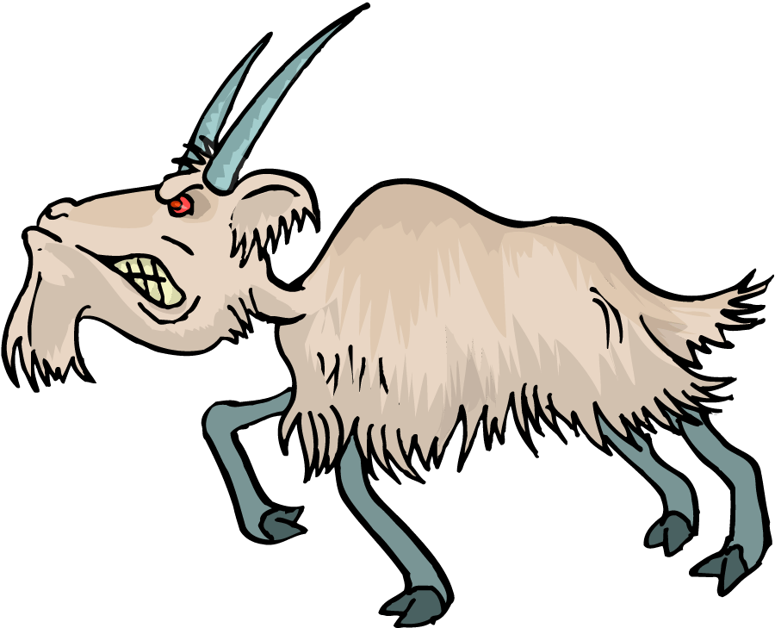
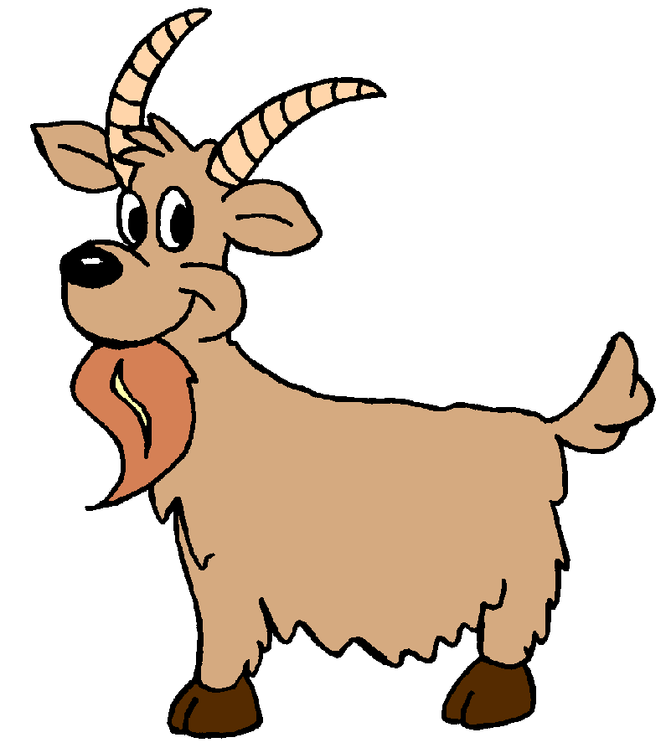
Q2
Loci (Dogs and Goats)
Scale:1cm = 3m
Billy the goat is tethered by a 15m long chain to a tree at A. Nanny the goat is tethered to the corner of a shed at B by a 12 m rope. Draw the boundary locus for both goats and shade the region that they can both occupy.
Wall
A
Shed
B
Wall
1. Draw arc of circle of radius 5 cm
2. Draw ¾ circle of radius 4 cm
3. Draw a ¼ circle of radius 1 cm
4. Shade in the required region.

Slide 27
Q3
Loci
Scale:1cm = 2km
The diagram shows a radio transmitter and a power line. A radio receiver will only work if it is less than 8km from the transmitter but more than 5 km from the power line. Shade the region in which it can be operated.
2 ½ cm
Radio Transmitter
Over head power Line
1. Draw dotted circle of radius 4 cm
2 ½ cm
2. Draw line parallel to power line and 2½ cm from it
3. Shade in required region

Slide 28

EXQ4
A farmer wants to lay a water pipe across his field so that it is equidistant from two boundary hedges. He also wants to connect a sprinkler in the exact centre of the pipe, that waters the field for 40 metres in all directions.
(a) Show the position of the pipe inside the field. (b) Mark the point of connection for the sprinkler. (c) Show the area of the field that is watered by the sprinkler.
C
D
B
1. Bisect angle BAE.
2. Bisect line of pipe and locate centre.
hedge
E
3. Draw circle of radius 2 cm and shade.
hedge
A
Scale:1cm = 20m

Slide 29
Q5
Another farmer wants to lay a water pipe across his field so that it is equidistant from two boundary hedges. He also wants to connect a sprinkler in the exact centre of the pipe, that waters the field for 45 metres in all directions.
(a) Show the position of the pipe inside the field. (b) Mark the point of connection for the sprinkler. (c) Show the area of the field that is watered by the sprinkler.
C
D
B
hedge
1. Bisect angle AED.
2. Bisect line of pipe and locate centre.
3. Draw circle of radius 3 cm and shade.
E
hedge
A
Scale:1cm = 15m

Slide 30
EXQ6
Three towns are connected by 2 roads as shown. Three wind turbines are to be positioned to supply electricity to the towns. The row of three turbines are to be placed so that they are equidistant from both roads. The centre turbine is to be equidistant from Alton and Bigby. The turbines are to be 400 m apart.
(a) Show the line on which the turbines must sit. (b) Find the position of the centre turbine. (c) Show the position of the other two.
Bigby
1. Bisect angle BAC.
Alton
2. Bisect line AB and locate centre turbine.
3. Mark points 2cm from centre turbine.
Catford
Scale:1cm = 200m

Slide 31

Q7
A military aircraft takes off on a navigation exercise from airfield A. As part of the exercise it has to fly exactly between the 2 beacons indicated. There is a radar station at R with a range of coverage of 40 miles in all directions.
A
Determine the flight path along which the aircraft must fly.
Will the radar station be able to detect the aircraft during the flight?
B₂
1. Draw straight line between B₁ and B₂ and bisect.
2. Locate midpoint and join to A.
R
B₁
3. Draw a circle of radius 2 cm
Scale:1cm = 20miles
Aircraft not detected

Slide 32
Worksheet 1
EX Q 1
Squares only ≈ cm
Loci (Dogs and Goats)
Scale:1cm = 2m
Buster the dog is tethered by a 10m long rope at the corner of the shed as shown in the diagram. Draw and shade the area in which Buster can move.

Slide 33
Worksheet 2
Q2
Squares only ≈ cm
Loci (Dogs and Goats)
Scale:1cm = 3m
Billy the goat is tethered by a 15m long chain to a tree at A. Nanny the goat is tethered to the corner of a shed at B by a 12 m rope. Draw the boundary locus for both goats and shade the region that they can both occupy.
Wall
A
Shed
B
Wall

Slide 34
Worksheet 3
Q3
Squares only ≈ cm
Loci
Scale:1cm = 2km
The diagram shows a radio transmitter and a power line. A radio receiver will only work if it is less than 8km from the transmitter but more than 5 km from the power line. Shade the region in which it can be operated.
Radio Transmitter
Over head power Line

Slide 35
Worksheet 4
EXQ4
A farmer wants to lay a water pipe across his field so that it is equidistant from two boundary hedges. He also wants to connect a sprinkler in the exact centre of the pipe, that waters the field for 40 metres in all directions.
(a) Show the position of the pipe inside the field. (b) Mark the point of connection for the sprinkler. (c) Show the area of the field that is watered by the sprinkler.
C
D
B
hedge
E
A
hedge
Scale:1cm = 20m
Squares only ≈ cm

Slide 36
Worksheet 5
Q5
Another farmer wants to lay a water pipe across his field so that it is equidistant from two boundary hedges. He also wants to connect a sprinkler in the exact centre of the pipe, that waters the field for 45 metres in all directions.
(a) Show the position of the pipe inside the field. (b) Mark the point of connection for the sprinkler. (c) Show the area of the field that is watered by the sprinkler.
C
D
B
hedge
E
hedge
A
Scale:1cm = 15m
Squares only ≈ cm

Slide 37
Worksheet 6
Three towns are connected by 2 roads as shown. Three wind turbines are to be positioned to supply electricity to the towns. The row of three turbines are to be placed so that they are equidistant from both roads. The centre turbine is to be equidistant from Alton and Bigby. The turbines are to be 400 m apart.
EXQ6
(a) Show the line on which the turbines must sit. (b) Find the position of the centre turbine. (c) Show the position of the other two.
Bigby
Alton
Catford
Scale:1cm = 200m
Squares only ≈ cm

Slide 38
Worksheet 7
Q7
A military aircraft takes off on a navigation exercise from airfield A. As part of the exercise it has to fly exactly between the 2 two beacons indicated. There is a radar station at R with a range of coverage of 40 miles in all directions.
A
Determine the flight path along which the aircraft must fly.
Will the radar station be able to detect the aircraft during the flight?
B₂
R
B₁
Scale:1 cm = 20miles
Squares only ≈ cm

Slide 39
Perp Bisec Proof
To Prove that CD bisects AB at M.
C
A
M
B
D
Arcs lie on the circumference of circles of equal radii.
AC = AD = BC = BD (radii of the same circle).
Triangles ACD and BCD are congruent with CD common to both (SSS).
So Angle ACD = BCD
Triangles CAM and CBM are congruent (SAS)
Therefore AM = BM QED

Slide 40
Ang Bisect Proof
To prove that AG is the Angle Bisector of CAB
C
D
G
F
A
E
B
AD = AE (radii of the same circle)
DG = EG (both equal to radius of circle DE)
Triangle ADG is congruent to AEG (AG common to both) SSS
So angle EAG = DAG
Therefore AG is the angle bisector of CAB QED

Slide 41
CM SQ

